Slide 1

The Gospel of Mark
Familiarity and failure
Mark 6:1- 6

Slide 2

ICebreaker

Slide 3
Does Familiarity Breed complacency or contempt?
It is harder or easier to ask probing questions the longer you have been in the Christian faith? Why or why not?
It is harder or easier to become cynical the longer you have been in the Christian faith? Why or why not?
Is it harder or easier to see God working around you the longer you have been in the Christian faith? Why or why not?
Revelations 2:1-4 1 "To the angel of the church in Ephesus write: … I know your deeds, your hard work and your perseverance. … You have persevered and have endured hardships for my name, and have not grown weary. Yet I hold this against you: You have forsaken the love you had at first.
Do you think familiarity with Christianity had any influence at Ephesus? Does it impact us today?

Slide 4
Mark 6:1-6
Jesus returns home

Slide 5
Mark 6:1-26 – jesus returns home
1 Jesus left there and went to his hometown, accompanied by his disciples. 2 When the Sabbath came, he began to teach in the synagogue, and many who heard him were amazed. "Where did this man get these things?" they asked. "What's this wisdom that has been given him? What are these remarkable miracles he is performing? 3 Isn't this the carpenter? Isn't this Mary's son and the brother of James, Joseph, Judas and Simon? Aren't his sisters here with us?" And they took offense at him. 4 Jesus said to them, "A prophet is not without honor except in his own town, among his relatives and in his own home." 5 He could not do any miracles there, except lay his hands on a few sick people and heal them. 6 He was amazed at their lack of faith. Then Jesus went around teaching from village to village.

Slide 6

Morgan wallen is not jesus

Slide 7
Mark 6:1-26 – jesus returns home
1 Jesus left there and went to his hometown, accompanied by his disciples. 2 When the Sabbath came, he began to teach in the synagogue, and many who heard him were amazed. "Where did this man get these things?" they asked. "What's this wisdom that has been given him? What are these remarkable miracles he is performing? 3 Isn't this the carpenter? Isn't this Mary's son and the brother of James, Joseph, Judas and Simon? Aren't his sisters here with us?" And they took offense at him. 4 Jesus said to them, "A prophet is not without honor except in his own town, among his relatives and in his own home." 5 He could not do any miracles there, except lay his hands on a few sick people and heal them. 6 He was amazed at their lack of faith. Then Jesus went around teaching from village to village.
Notes:
Also recorded in Matt 13 nearly verbatim.
Also recorded in Luke 4, but with significantly more detail if we assume the events are the same.

Slide 8
What did they know about jesus? previous miracles in mark
Demons & Healings in Capernaum (Chapter 1)
Paralytic in Chapter 2
Paralyzed hand in Chapter 3
Demoniac in Chapter 4
Raised the Dead in Chapter 5
Healed the hemorrhaging woman in Chapter 5
How does familiarity with Jesus make it difficult for them to get past the question of “What are these remarkable miracles he is performing?”
How does familiarity impact our ability to see God working around us today?

Slide 9
What was Jesus Reputation in his hometown?
The term “Carpenter” implies that Jesus was the local tradesman, the handyman, within his hometown.
Carpenters and Laborers were blue-collar and not considered an esteemed profession.
Culture at the time did not see people as rising above their class.
How does familiarity with Jesus and the culture make it difficult for them to get past the questions of “What's this wisdom that has been given him? Isn't this the carpenter?
How does culture and familiarity impact our ability to see how God can use the lowly of society?
Where else in scripture do we see God using the lowest of society to accomplish His will?

Slide 10
failure
What do you think the disciples expectations were for Jesus’ homecoming? (see Mark 3:21)
What do you think the disciples thought afterwards? Do you consider this a failure?
Why do you think Mark (And Matthew and Luke) felt this event was important enough to include in the Gospels?
How is this passage applicable to us in sharing the Gospel with those we are closest to?
Jesus left there and went to his hometown, accompanied by his disciples
He could not do any miracles there, except lay his hands on a few sick people and heal them. He was amazed at their lack of faith.
The passage implies that Jesus could not do many miracles because his hometown did not give him the opportunity. He healed those who were bought to him. Matthew 13:58 says “did not do”.
Why do you think the townspeople wouldn’t have been excited and met Jesus with expectation and huge groups of people needing healing?

Slide 11
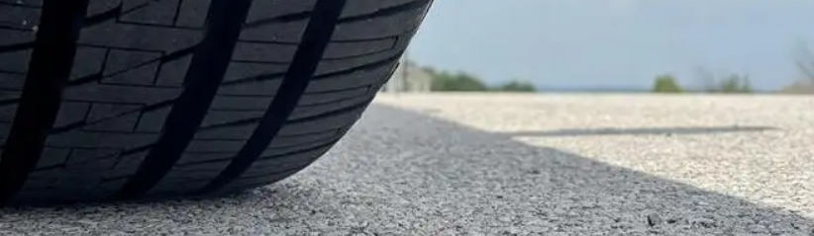
Application – familiarity & failure

Slide 12
The Problem with Familiarity
Does it become more difficult to Identify Jesus the longer you have been a Christian? Why or why not?
What steps should we take to combat the cynicism that can come with familiarity?
This is the second time we’ve seen a “group” of people reject Jesus (the Gerasenes and his hometown) – What does this tell us about the impacts of doubt or suspicion within a community?
The townspeople ask these questions:
  Where did this man get these things
  What's this wisdom that has been given him
  What are these remarkable miracles he is performing
  Isn't this Mary's son and the brother of James, Joseph, Judas and Simon
They do not ask “Who is Jesus?” or “What does this mean?”

Slide 13
Expectations and Failure
In this story, we see Jesus rejected by the Gerasenes and rejected by his hometown.
Paul met resistance and persecution in Antioch, Iconium, Thessalonica, Athens – this was a theme in Acts!
Is it easier or harder to evangelize those you know compared to those you don’t know?
Should we be surprised when our family or strangers reject the Gospel?

Slide 14

Up Next
7/7 JD Mark 6:7-30
7/14 Rhett Mark 6:31-44
7/21 Josh Mark 7:1-23
7/28 Rhett Mark 7:24-37
8/4 Rhett Mark 8:1-26

Slide 15
Selecting visual aids
Enhancing your presentation

Slide 16
Effective delivery techniques
This is a powerful tool in public speaking. It involves varying pitch, tone, and volume to convey emotion, emphasize points, and maintain interest.
Pitch variation
Tone inflection
Volume control
Effective body language enhances your message,
making it more impactful and memorable.
  Meaningful eye contact
  Purposeful gestures
  Maintain good posture
  Control your expressions

Slide 17
Navigating Q&A sessions
Know your material in advance
Anticipate common questions
Rehearse your responses
Maintaining composure during the Q&A session is essential for projecting confidence and authority. Consider the following tips for staying composed:
  Stay calm
  Actively listen
  Pause and reflect
  Maintain eye contact

Slide 18

Speaking impact
Your ability to communicate effectively will leave a lasting impact on your audience
Effectively communicating involves not only delivering a message but also resonating with the experiences, values, and emotions of those listening

Slide 19
Dynamic delivery
Learn to infuse energy into your delivery to leave a lasting impression
One of the goals of effective communication is to motivate your audience
Impact factor | Measurement | Target | Achieved
Audience interaction | Percentage (%) | 85 | 88
Knowledge retention | Percentage (%) | 75 | 80
Post-presentation surveys | Average rating | 4.2 | 4.5
Referral rate | Percentage (%) | 10 | 12
Collaboration opportunities | # of opportunities | 8 | 10

Slide 20
Final tips and takeaways
Consistent rehearsal
  Strengthen your familiarity
Refine delivery style
  Pacing, tone, and emphasis
Timing and transitions
  Aim for seamless, professional delivery
Practice audience
  Enlist colleagues to listen & provide feedback
Seek feedback
Reflect on performance
Explore new techniques
Set personal goals
Iterate and adapt

Slide 21
Speaking engagement metrics
Impact factor | Measurement | Target | Achieved
Audience interaction | Percentage (%) | 85 | 88
Knowledge retention | Percentage (%) | 75 | 80
Post-presentation surveys | Average rating | 4.2 | 4.5
Referral rate | Percentage (%) | 10 | 12
Collaboration opportunities | # of opportunities | 8 | 10

Slide 22
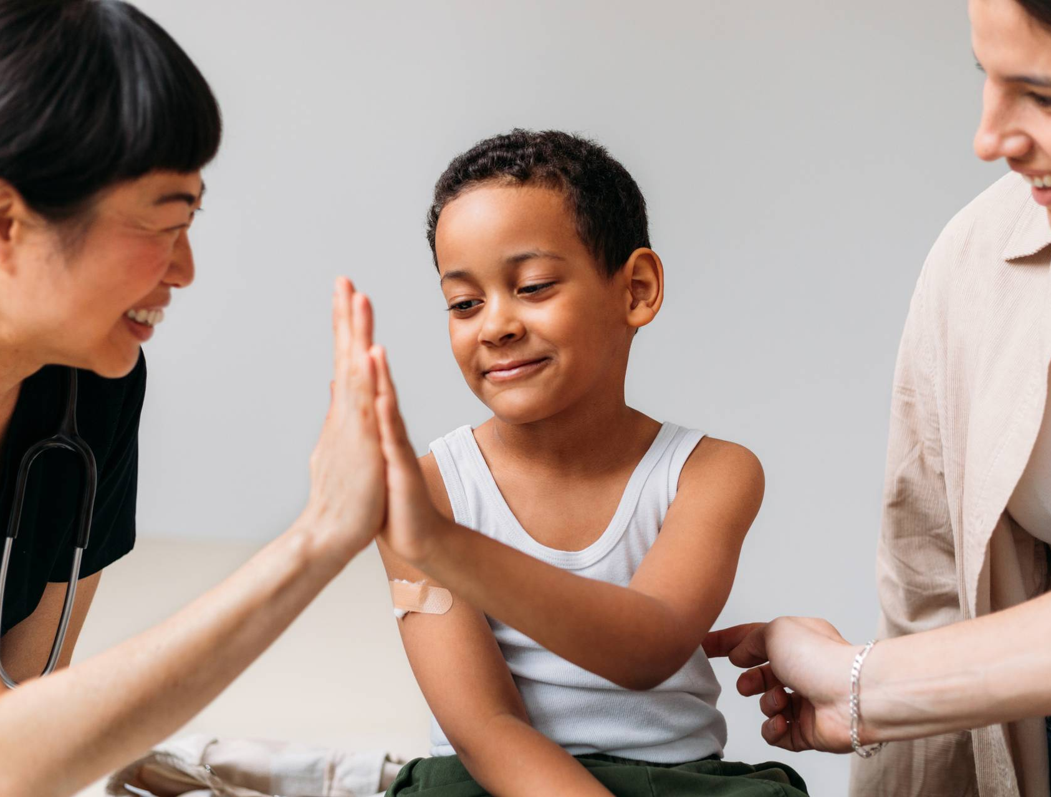
Thank you
Brita Tamm
502-555-0152
brita@firstupconsultants.com
www.firstupconsultants.com

